Slide 1
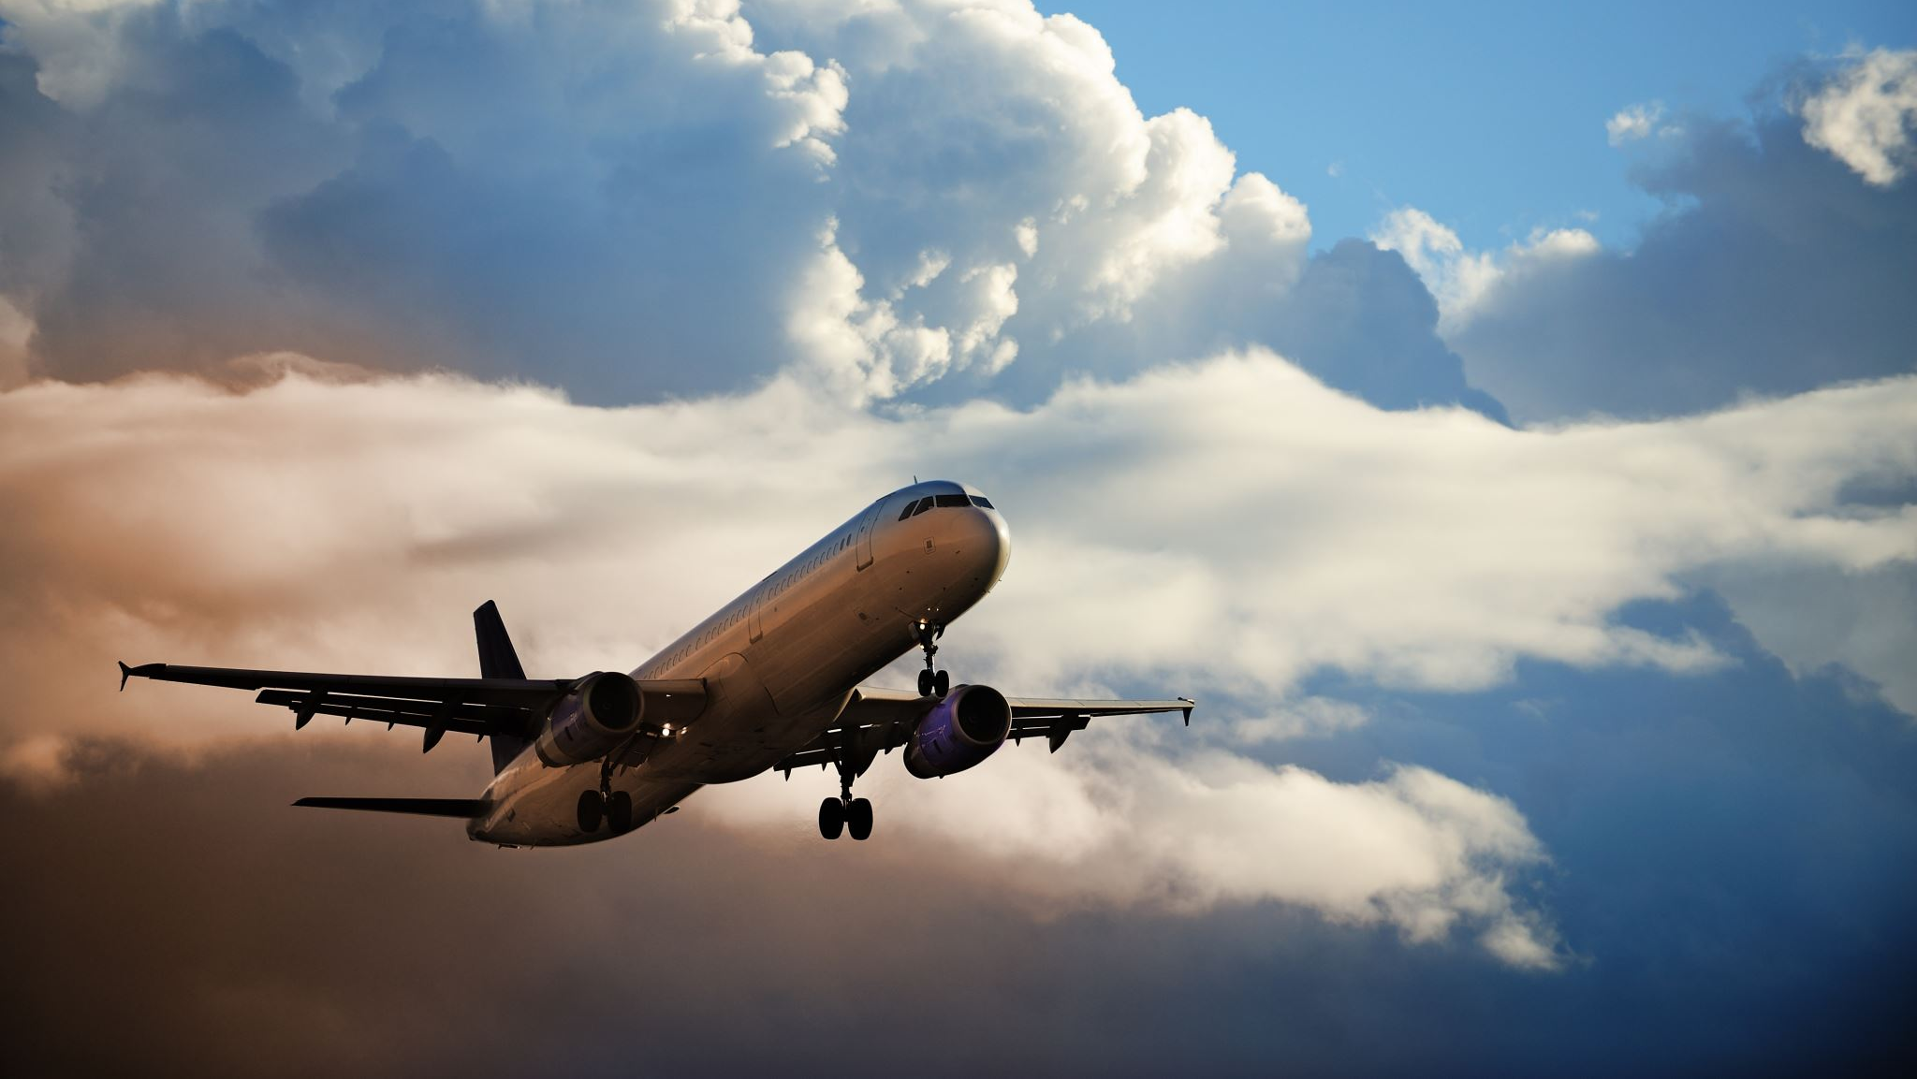


FLIGHT DELAY PREDICTIONS
Garrett Brezsnyak
Albina Mussilova
08.27.2021

Slide 2
OUTLINE
Overview
Workflow
Modeling Techniques
Exploratory Data Analysis
Results
Features used
Challenges

Slide 3

OVERVIEW
Predictions of delays can help to manage air traffic
They can be used to plan extra shifts for airport workers when many delays are expected
How fuel consumption can depend on delays

Slide 4
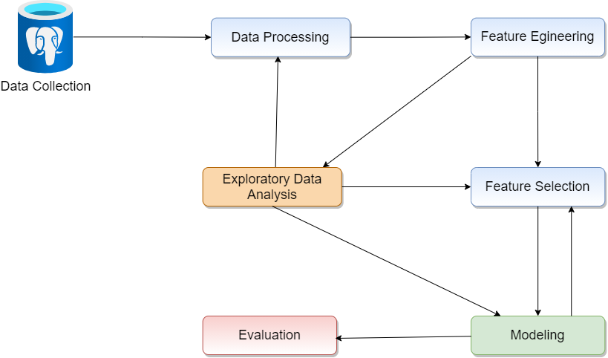
WORKFLOW

Slide 5

MODELING TECHNIQUES
Libraries used for Feature Engineering:
Pandas
Scipy
Seaborn
Plotly
Matplotlib
Numpy
Psycopg2 and postgresSQL
Libraries used for Modeling:
Sklearn
Xgboost
Pickle
Visual Crossing Weather API
Tools used:
Jupyter Labs
Google Colab
GitHub

Slide 6
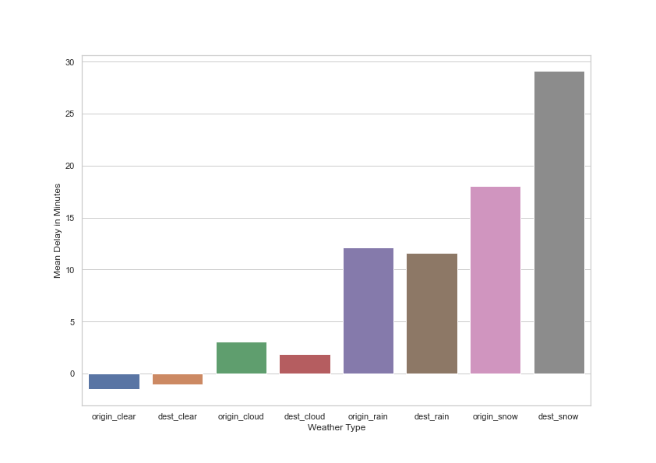
EXPLORATORY DATA ANALYSIS
Snow causes greatest delays
Snow delays impact destinations much more than origins
Clear weather generally results in lower delays
Different weather had a noticeable impact on the arrival delays, if we had more time it would have been very useful as a feature in model

Slide 7
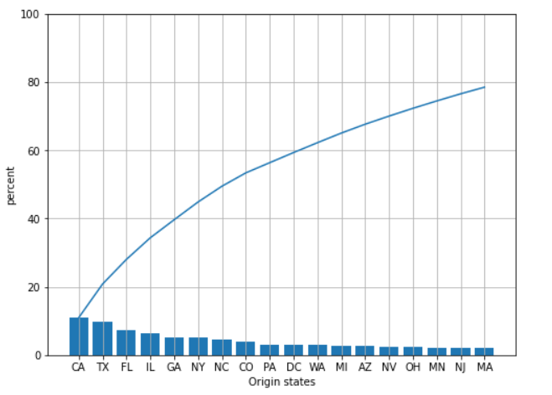
EXPLORATORY DATA ANALYSIS (CONT.)
Top 50% U.S. traffic
California
Texas
Florida
Illinois
Georgia
New York
North Carolina
Only 7 states out of 50 account
for half of the air traffic.

Slide 8
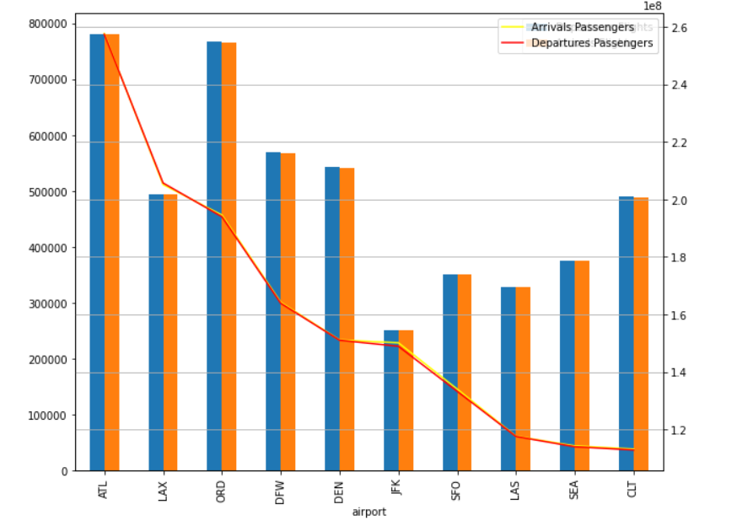

EXPLORATORY DATA ANALYSIS (CONT.)
Top 10 busiest airport:
Atlanta
Los Angeles
Chicago
Dallas
Denver
New York
San Francisco
Seattle
Las Vegas
Orlando
More customer service stuff or
open more entertainment facilities
at airport with high passenger
traffic

Slide 9
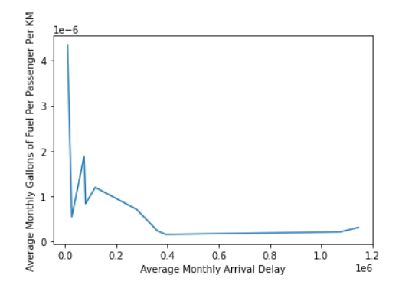
EXPLORATORY DATA ANALYSIS (CONT.)
Carriers with the lowest monthly arrival delay used more fuel per passenger per km than those with the larger average monthly arrival delay
It appears that delays do not appear to cause wasted fuel

Slide 10
MODELING TECHNIQUES
XGBoost
Random Forest Regression
Metrics for evaluation(R2, MSE)
Trained models on 5,000,000 randomly sampled flights that were not cancelled or diverted
Prior to sampling dropped flights that were delayed over 250 minutes or arrived over 60 minutes early as they seemed to be strong outliers

Slide 11

RESULTS
R2 = 0.149
RMSE = 31.82
Predictions
Achieved with XGBoost
Objective: reg:squarederror
max_depth = 15
alpha = 5
n_estimators = 250

Slide 12
FEATURES USED
Average origin and destination airport delay (hourly and weekly) from historical data
Airport traffic (hourly and weekly)
Flight number and flight type based on flight number
Flight distance encoding (Short, Medium, Long Haul)
Carrier encoding
Date & Time bins

Slide 13
CHALLENGES
Enormous data = Time Issues
Searching for perfect modeling settings
Including & excluding features
Weather API
Would have taken ~35 hours and cost ~$30 to pull all needed weather data for all flights in database

